Slide 1

Gossip, rumour, and propaganda: depictions and perceptions of Irish revolutionary violence
Dr Brian Hughes,
Mary Immaculate College, Limerick
Brian.Hughes@mic.ul.ie

Slide 2
5th Battalion Cork No. 5 Brigade
Civilians.
Occupation. | Ex-soldier
Description. | Age 28 years full face. Bloated look. Stout build. Walks with a bit of a roll
Address in Ireland. | West End. CTown-bere
Is the person still in residence there. | Yes
Address abroad if left Ireland. | -
Offences giving dates, places and particulars in detail. | This man was invalided out of the navy two years ago & ever since he came home here [he]was always in touch with police & military & always drinking with them. He was a constant visitor to the R.I.C. Barracks.
Short summary of evidence available in support of charges giving names of witnesses. | The only evidence is a very strong suspicion of this man. He was seen in company with Lt. Hatton-Hall on several occasions. Witnesses Daniel Harrington Jerh Crowley, Castletownbere.
IRA Intelligence file, early 1922 (MAI, A/0897)

Slide 3
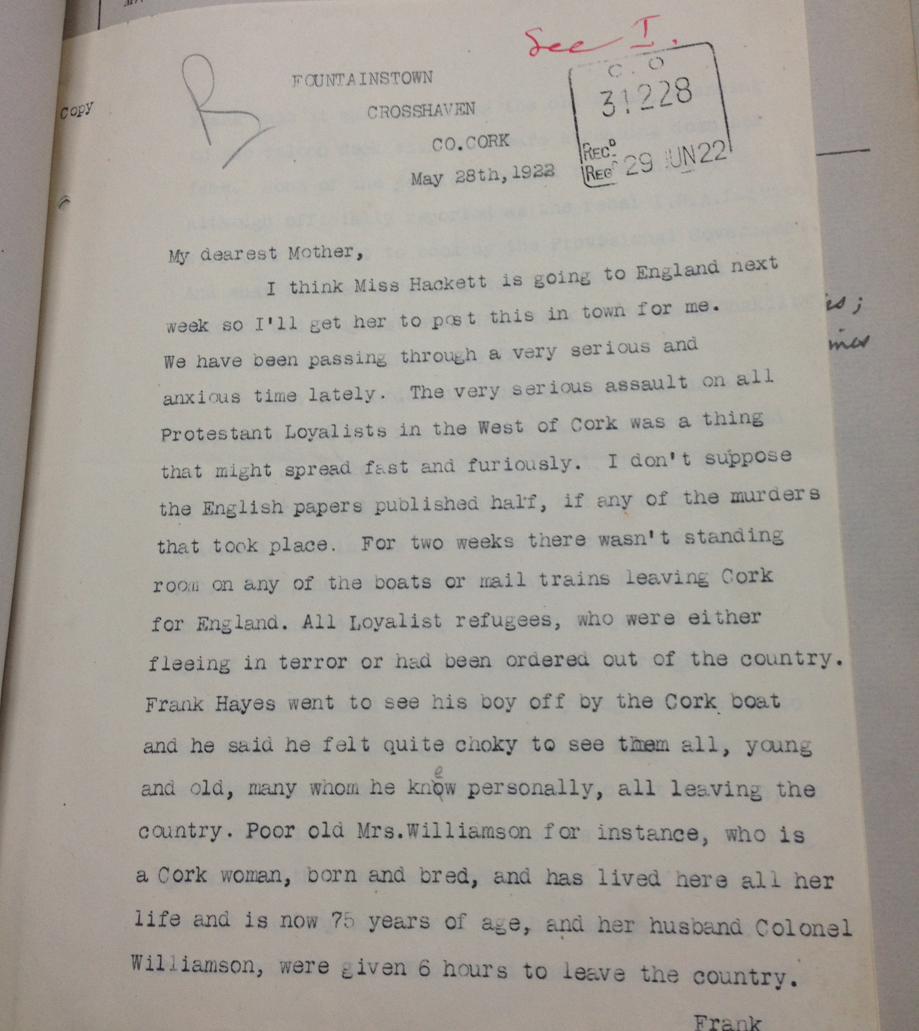
Alice Hodder to her mother, 28 May 1922 (TNA, CO 739/16).

Slide 4
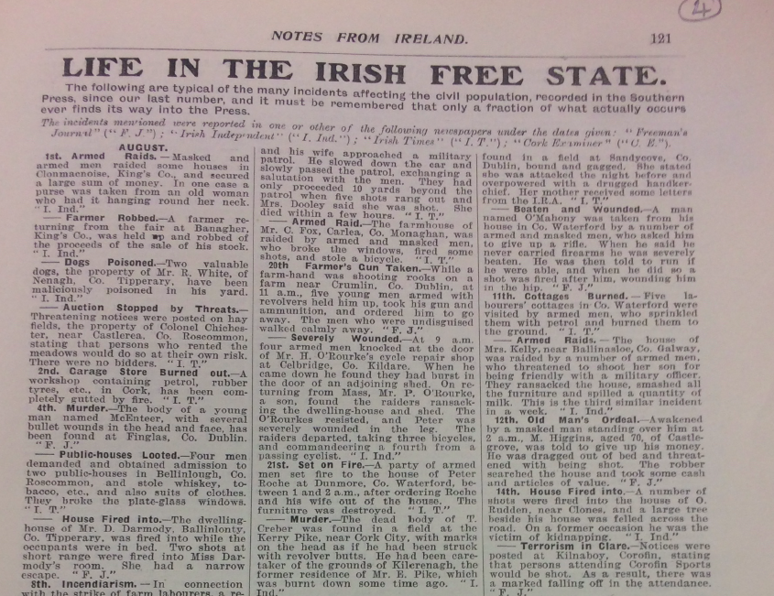
Notes from Ireland, Nov. 1923

Slide 5
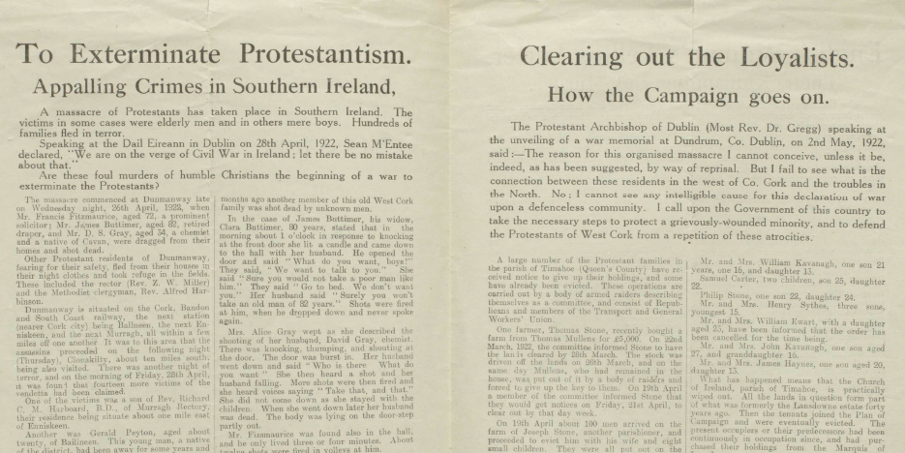
Pamphlet printed by the Belfast News-letter, c. 1922 (PRONI, D989/C/1/40)

Slide 6
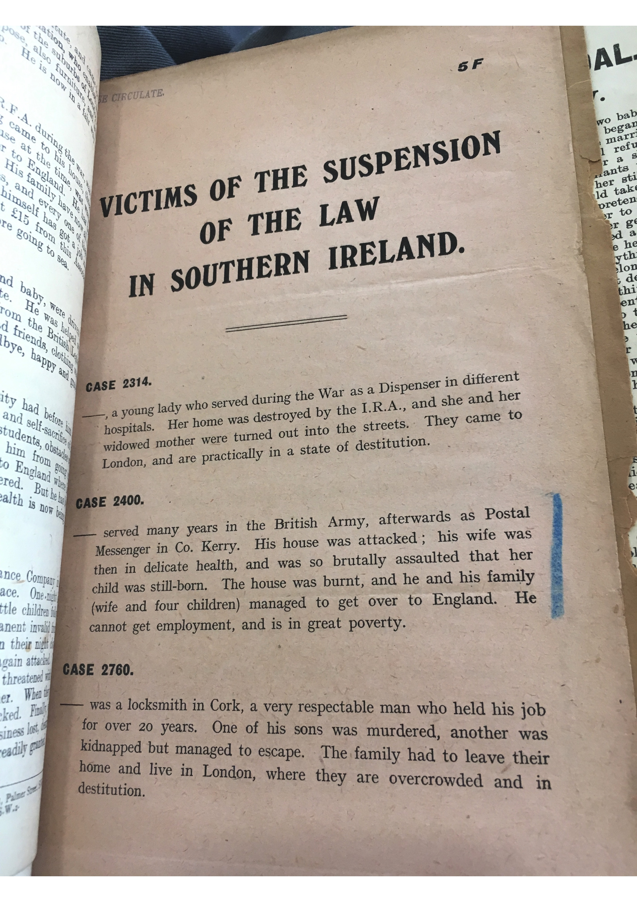
SILRA Pamphlet, n.d. (LSE, Coll Misc 0028)

Slide 7
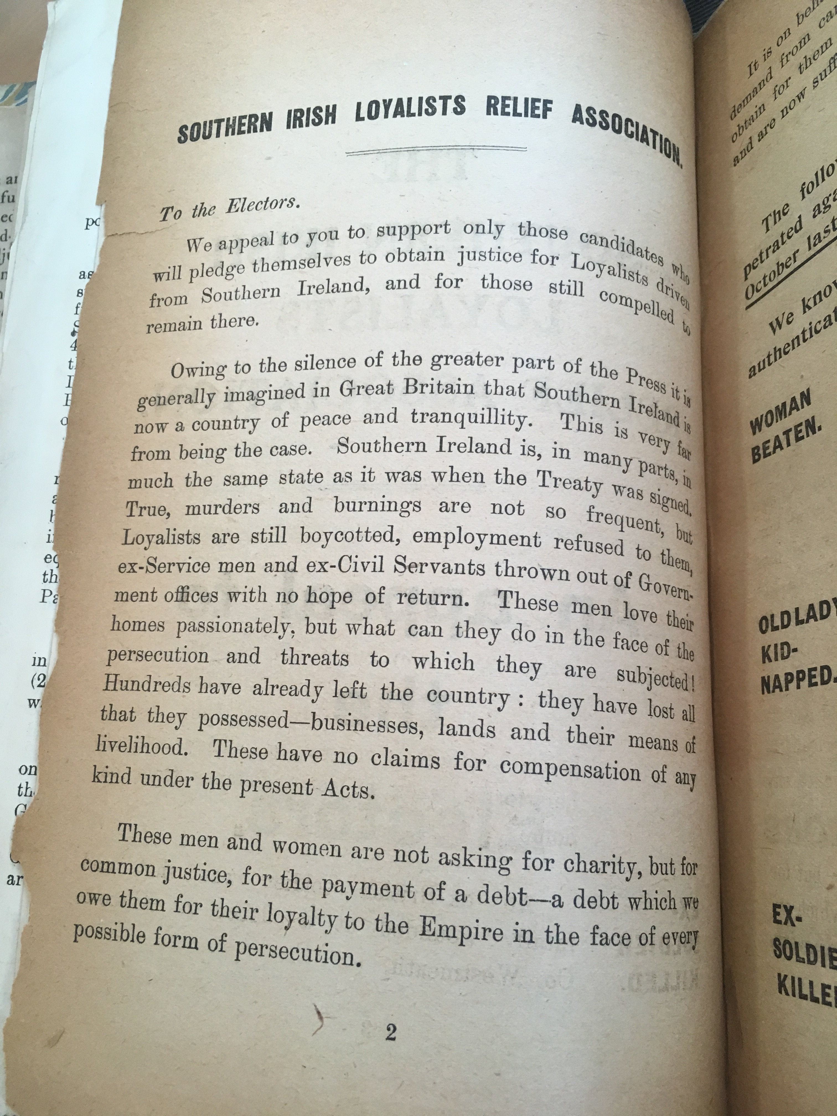
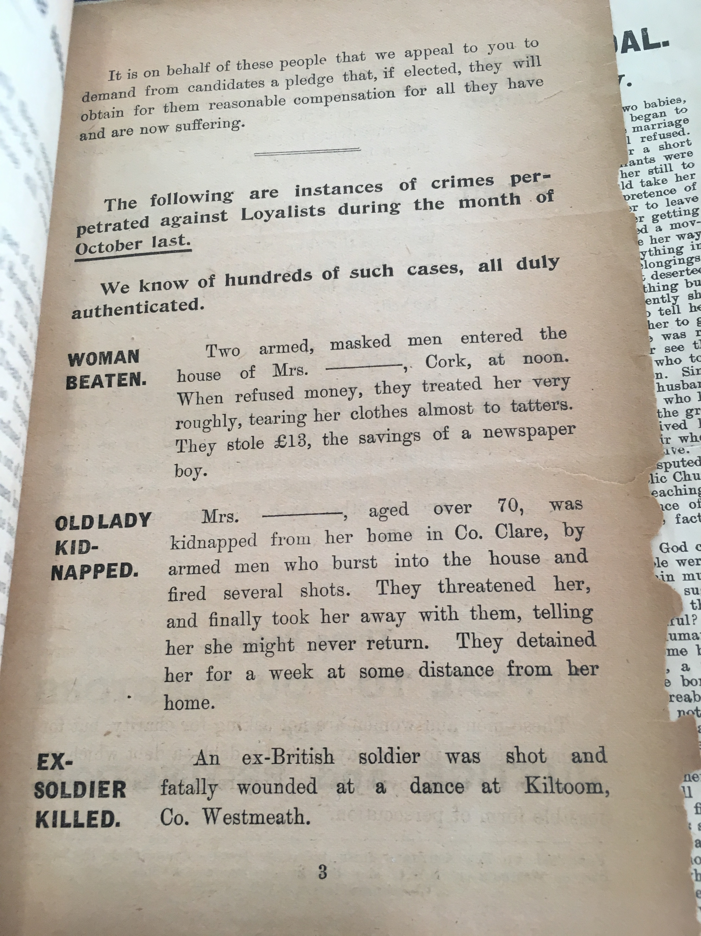
SILRA Pamphlet, c. 1923 (LSE, Coll Misc 0028)

Slide 8
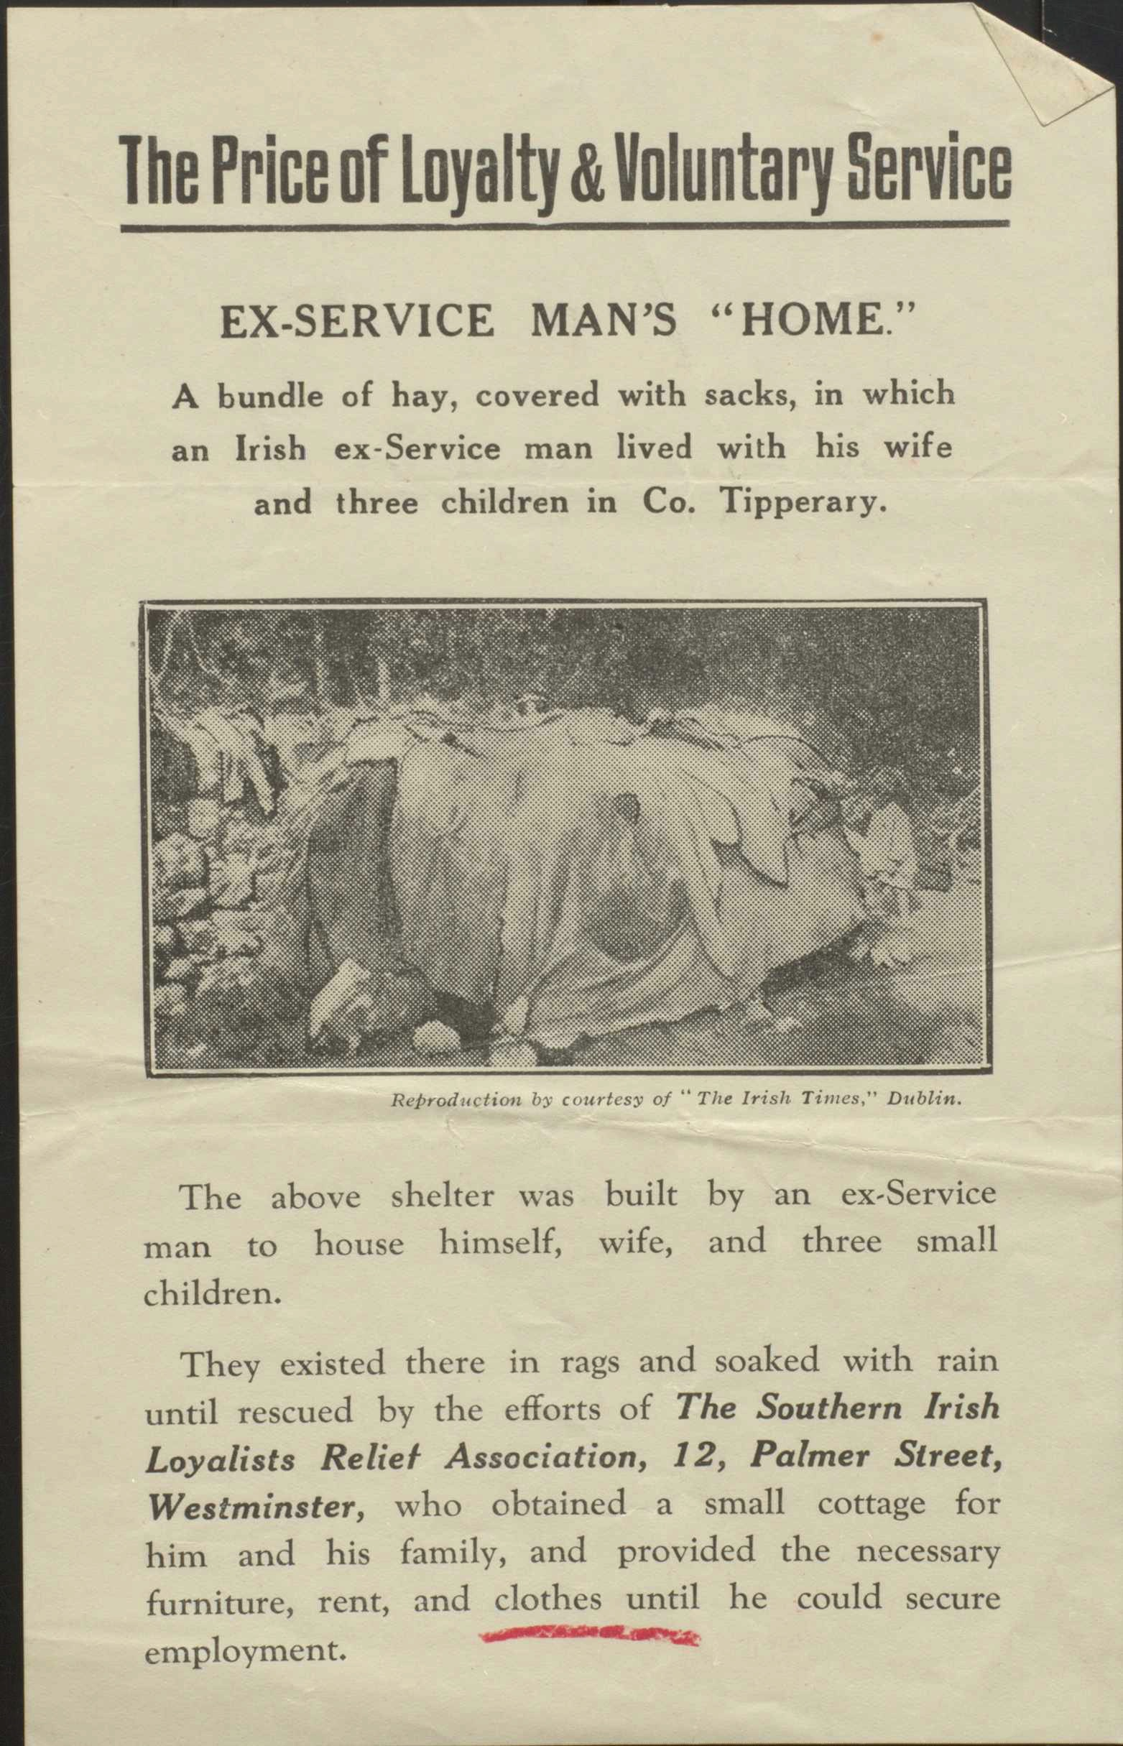
SILRA Pamphlet, n.d. (PRONI, D989/C/1/40)

Slide 9
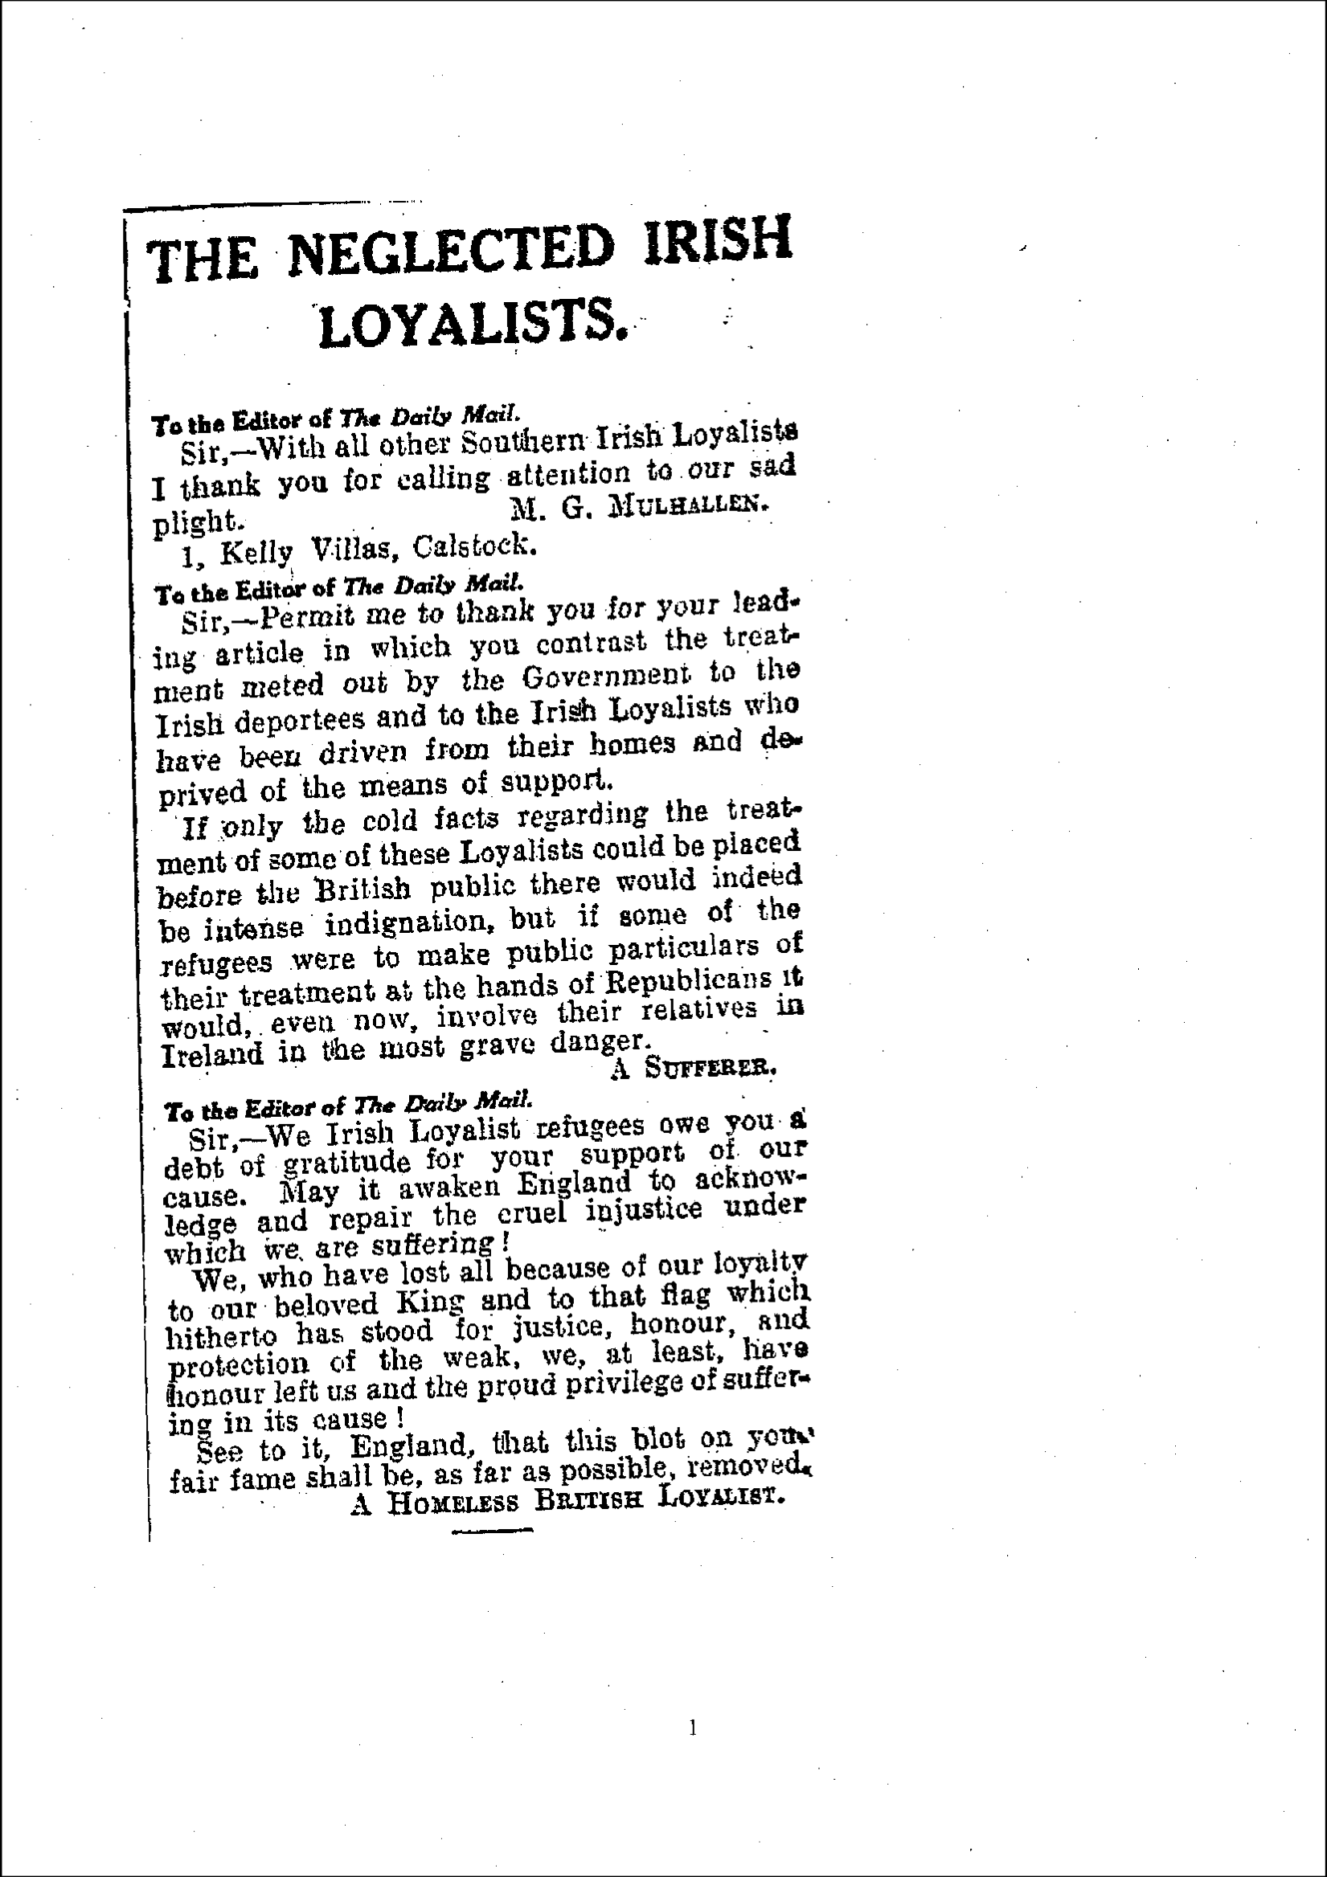
Daily Mail, 25 Oct 1923

